Slide 1
Photomicrographs of Plant foods
Chive
Permission to reproduce original photomicrographs used to make this collection may be obtained from
Dr. David O. Norris at
david.norris@colorado.edu

Slide 2
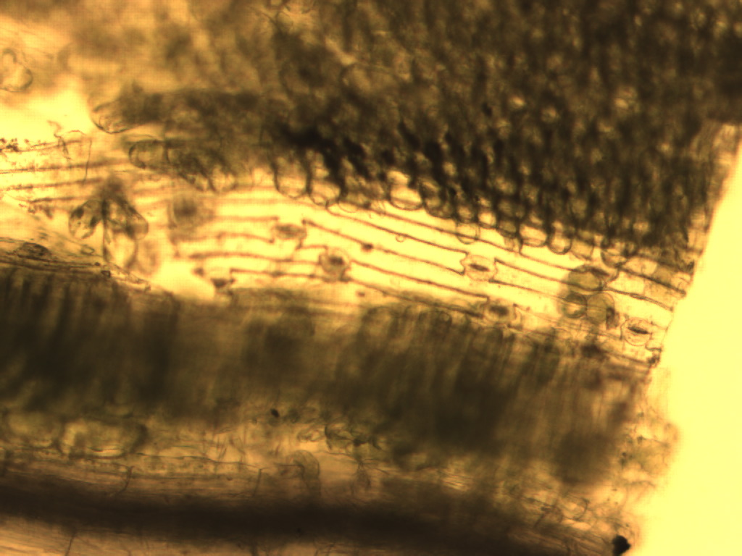
PSN
Notes:
128. Allium schoenoprasum L. Chive. Epidermis, 10X. Stomate (arrow) Photosynthetic parenchyma, PSN.

Slide 3
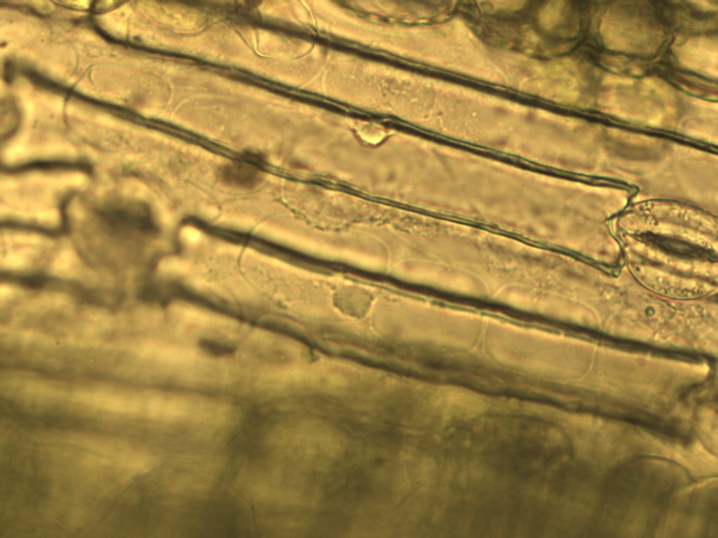
Notes:
129. Chive. Epidermis with stomate (arrow), 40X

Slide 4
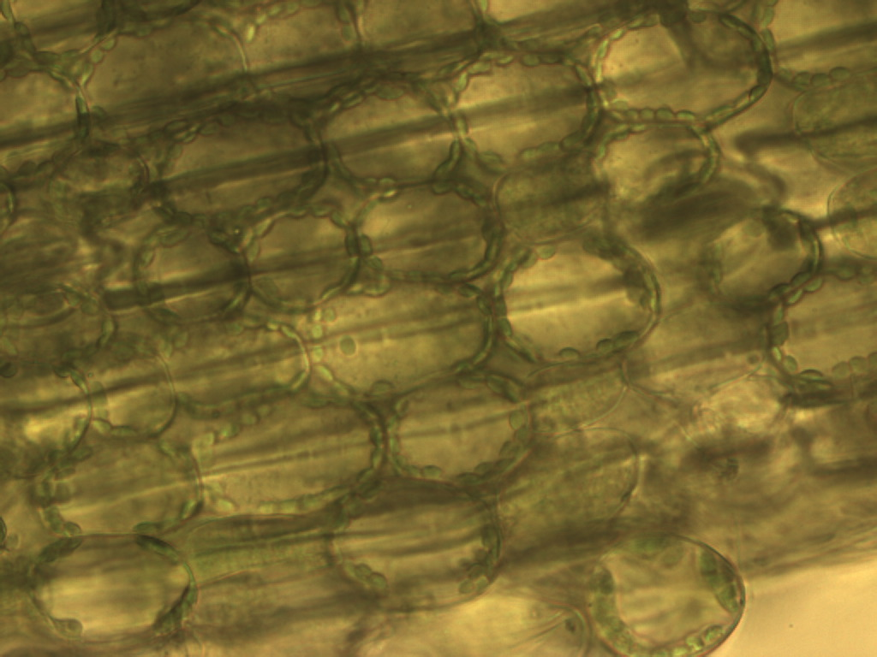
Notes:
130. Chive. Photosynthetic parenchyma, 40X.. Note chloroplasts (arrows) located adjacent to cell wall

